Slide 1

Lecture 8: ADB
Topics: Basic ADB Commands

Slide 2
What is ADB?
Android Debug Bridge (ADB) is a command line utility to communicate with your Android device.
Uses:
Listing connected devices.
Installing and debugging apps.
Copy files to and from the phone.
Take screenshots, record screens, etc.
<android_sdk_path>/platform-tools/adb.exe
Notes:
Power manage: wake lock, reboot.

Slide 3


ADB Client-Server Architecture
Three entities are involved: a client, a server, a daemon (adbd).
Client
Port: 5037
Server
Port: 555X
Daemon
Invoked From
Terminal
Background
process
Background
process
Notes:
Power manage: wake lock, reboot.

Slide 4
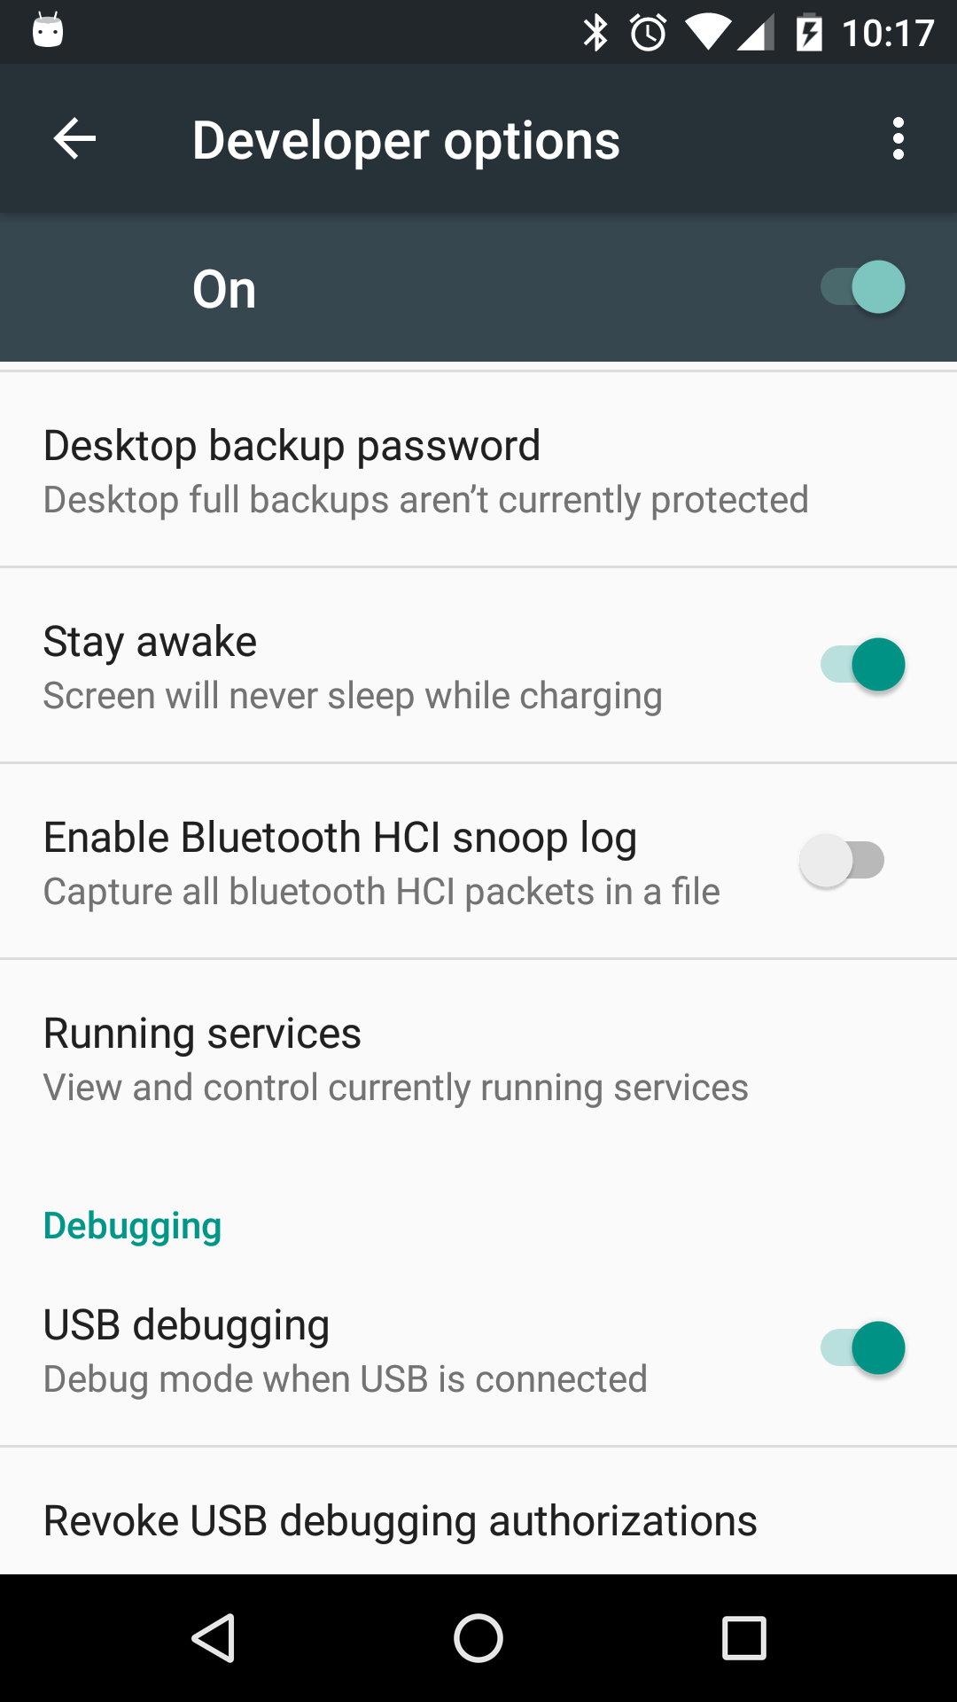
Connecting over USB
Remember the first thing we did with the phone?
Settings>About Phone> Build number
Settings>Developer options> USB Debugging
Why?
Notes:
Power manage: wake lock, reboot.

Slide 5

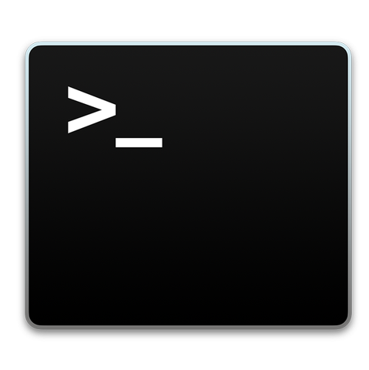
Testing the ADB
Use a shell to invoke your first command:
adb devices -l
List of devices attached
071b799a344bdc6b device product:hammerhead model:Nexus_5 device:hammerhead
USB
Notes:
Power manage: wake lock, reboot.

Slide 6
When things go wrong …
Use a shell to kill and start the server:
adb kill-server
adb start-server
* daemon not running. starting it now at tcp:5037 *
* daemon started successfully *
USB

Slide 7

ADB over WiFi
Set TCP port (over USB) and connect (over WiFi)
(USB must be connected)
adb tcpip 5555
(USB must be disconnected)
adb connect [Phone’s IP Addr]
To get your phone’s IP address: adb shell ifconfig

Slide 8

ADB Commands
Now, you can communicate with the phone.
adb shell screencap /sdcard/s.png
adb pull /sdcard/s.png <local>
or

Slide 9
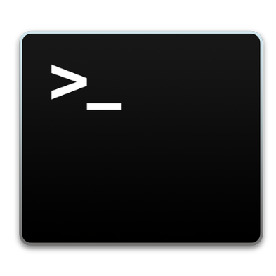
Useful ADB Commands
Global Options:
adb –d <command>
adb –e <command>
adb –s <serial number> <command>
071b799a344bdc6b
071b799a344bdxyz

Slide 10
Useful ADB Commands
General adb Commands:
adb devices -l
adb help
adb version
Network/File/Install adb Commands:
adb connect ip[:port]
adb disconnect ip[:port]
adb pull [-a] remote local
adb push local remote
adb install package
adb uninstall package

Slide 11
Useful ADB Commands
backup/debug/scripting adb Commands:
adb backup [-f file] [-apk][-obb][-shared][-all][-system]
adb restore file
adb logcat [option]
adb root
adb unroot
adb usb
adb tcpip port_555X
adb start-server
adb kill-server
adb reconnect

Slide 12
Issuing shell Commands
Generic format (two ways):
adb shell <command> (execute on device shell)
adb shell (get a device shell)
Activity Manager (am commands)
am start [option] intent (e.g., -a android.media.action.VIDEO_CAMERA)
am start
am startservice [option] intent
am broadcast [option] intent
am force-stop package
am kill [option] package
am kill-all
-n yourpackagename/.activityname

Slide 13
Issuing shell Commands
Package Manager (pm commands)
pm list packages [options] filter
pm list permissions [options] filter
pm list features
pm list libraries
pm list users
pm install [options] path
pm uninstall [options] package
pm grant package permission
pm revoke package permission
Screen capture
screencap filename
screenrecord [option] filename

Slide 14
Issuing shell Commands
Many more Unix commands!
echo text
date
time
reboot
ifconfig
iftop
netstat
ping host
ls
cd directory
chmod
df
mkdir
rm file
rmdir dir
ps
top

Slide 15
Shell commands from Android APPs
Use ‘Runtime’ and ‘Process’ classes to issue shell commands from an Android app:
try { Process p = Runtime.getRuntime().exec("ps");
InputStreamReader isr = new InputStreamReader(p.getInputStream()); BufferedReader br = new BufferedReader(isr); String str ="";
while((str = br.readLine()) != null){ Log.v("Tag", str); } } catch (IOException e) { e.printStackTrace(); }

Slide 16
References
https://developer.android.com/studio/command-line/adb.html
Notes:
Power manage: wake lock, reboot.

